Slide 1
6th Grade
Toronto Trip -
The Ontario Experience
June 2-3, 2016

Slide 2
History of our trip:
The Toronto trip has been a part of Saline’s 6th grade curriculum since 1982!
We have run this itinerary several times, tweaked it, and made improvements to help students get a true feel for Canadian customs & culture. Our itinerary includes a little something for everyone; Government (Parliament), Romantics (the castle), History (Fort York & ROM), and even Dare Devils (the CN Tower’s glass floor).
Every year we are proud of our students for their outstanding behaviors. They are well versed before the trip on the itinerary & our expectations. We hold our students to very high expectations and consider this a “business trip” for school. As a result, we are often proudly accept compliments from employees of the various venues, our travel agent, bus drivers, and other tourists.

Slide 3
Rules & Regulations
Safety -
The safety of our students is primary! It is mandatory for our students to stay within hearing distance and sight of their chaperone at all times! Students are required to use the “buddy system” for restroom breaks. Chaperones always accompany students on elevators and in stairwells. In summary, a student is NEVER left without immediate adult supervision.
Crossing the border -
Crossing the international border is serious business! Students will be cooperative with customs officials and speak only when spoken to.

Slide 4
Rules & Regulations
Rooms -
No more than 4 students will be assigned to a room. Chaperone & teacher rooms are on the same floor, spread out between students rooms. We are usually assigned separate floors for boys & girls. Students are responsible for any damages to their hotel rooms or the articles in it. Curfew is strictly enforced at the hotel! Students are to be in bed and quiet at the time of lights out! Teachers and security guards monitor the hallways until all giggling has ceased & rooms are quiet.
Promptness -
It is essential that all trip participants be on time for all activities.
Purchases -
All items purchased while on the trip must be consistent with school policies.

Slide 5
Thursday Morning - Rise & Shine!
4:15 am Arrive at Saline Middle School
Find your chaperone in the gymnasium (by teacher)
Give all medications to your trip’s medical representative.
Make sure luggage is marked with name
Use the bathroom and board the bus
5:00 am Buses leave

Slide 6
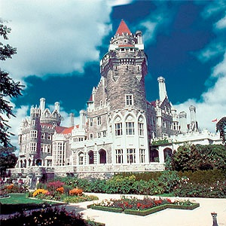
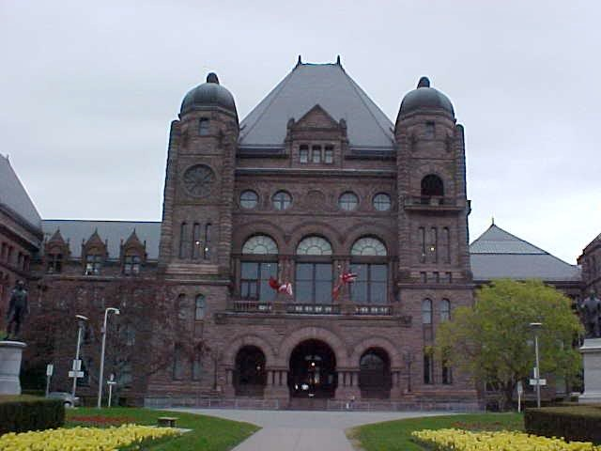
Thursday Morning & Afternoon:
CN Tower
Ontario Legislative Assembly
Parliament
Casa Loma

Slide 7
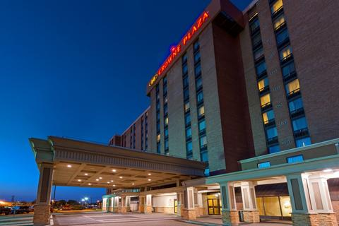
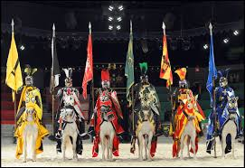
Thursday Evening
Dinner at Medieval Times
Check in at
Crowne Plaza – Toronto Airport
Lights Out - 10:30 pm SHARP!

Slide 8
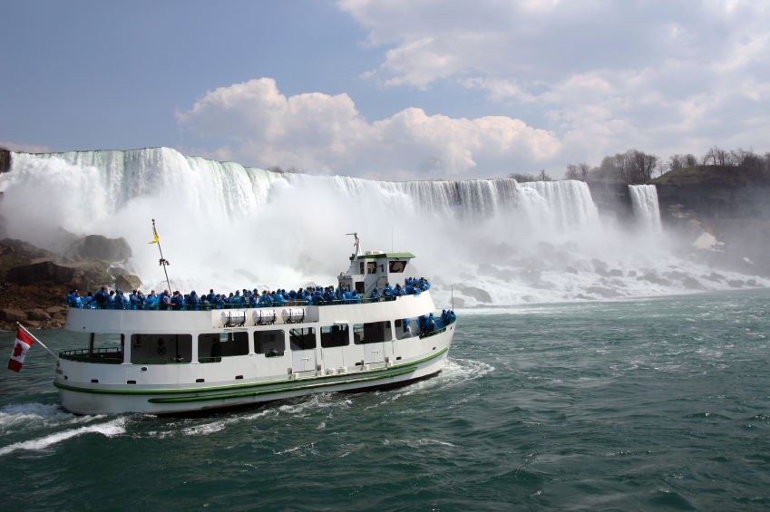
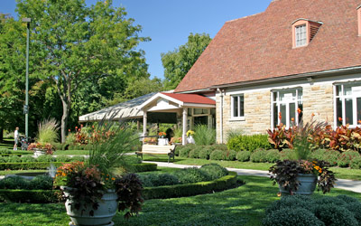
Friday - Bright & Early!
Breakfast Buffet
Niagara Falls
Maid of the Mist
Dinner at Queenston
Heights Pavillion
Shopping at Clifton Hills

Slide 9
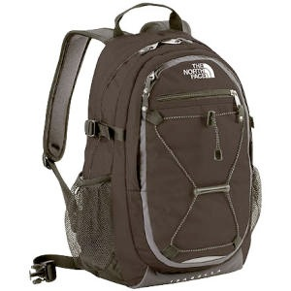
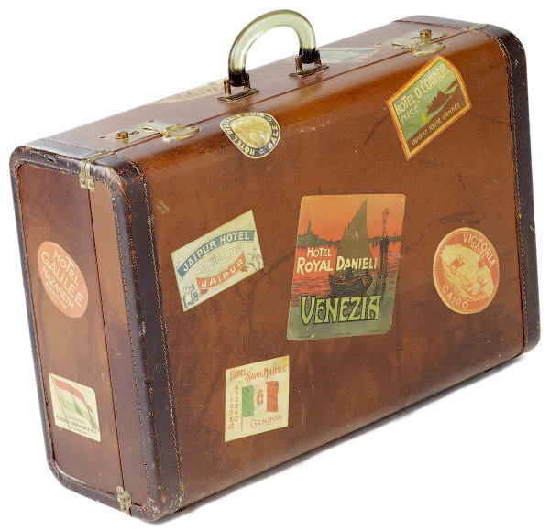
What to pack:
NOTE: Label all personal items with full name and address.
Day bag - for the bus ride:
Camera(s)
Spending money (optional)
Books, games, etc. for bus ride
Jacket or raincoat
Disposable bagged breakfast & lunch
Overnight bag –
Students will not have access to this bag until hotel check-in
Change of clothes for Friday (consider a second pair of shoes)
Toiletries (please don’t forget deodorant!)
Pajamas
PLEASE :
Limit junk food & beverages high in sugar or caffeine! Pack HEALTHY, HEARTY foods & plenty of WATER!

Slide 10
Please Remember:
Your child is allowed to bring their cell phone
They will be responsible for their usage of the International data
There will be WiFi on the charter bus but it is very limited and no guarantee that your student will be able to use it throughout the trip.
All WiFi will be turned off once we cross into Canada and will be turned back on once we enter the United States.

Slide 11
What NOT to pack:
Electronic games or other devices including I-Pods, Nintendo DS, etc.
Glass bottles, or those with tab openings. Screw-top containers only
Short shorts, sleeveless tops, mini skirts, sweat pants, pajama style pants
Super-sized luggage, it’s really just one night!
Perfume / cologne
PLEASE HELP ENSURE THAT YOUR CHILD DOES NOT BRING THE ABOVE ITEMS!
Some students have a hard time believing they can survive 2 days without them, but they will have a wonderful time interacting with their peers and taking in the sites without these distractions!

Slide 12
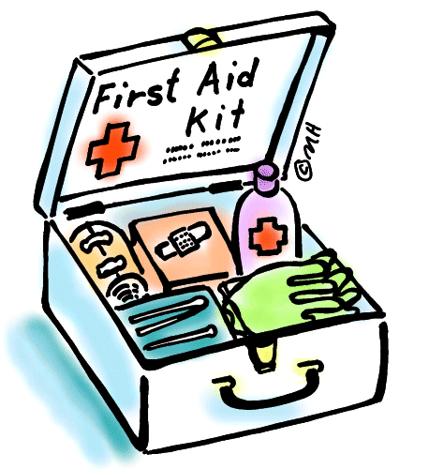
Health Forms & Medications
Epi-pens and inhalers must be carried by the individual student
All other medications must be carried by the trip nurse & will be dispensed as needed. An additional medication dispensing form is required for all “regular” meds
Dramamine, or any other motion-sickness medication should be taken PRIOR to your arrival at Saline Middle School with an additional supply for the return trip.
We will carry a supply of over-the-counter medications including motion-sickness medication, pain reliever, and general first aid products. These medications will NOT be given to your child unless the health form indicates permission to do so if necessary
ALL prescription medications must be in the ORIGINAL container from the pharmacy with directions clearly labeled. The trip nurse will dispense these medications

Slide 13
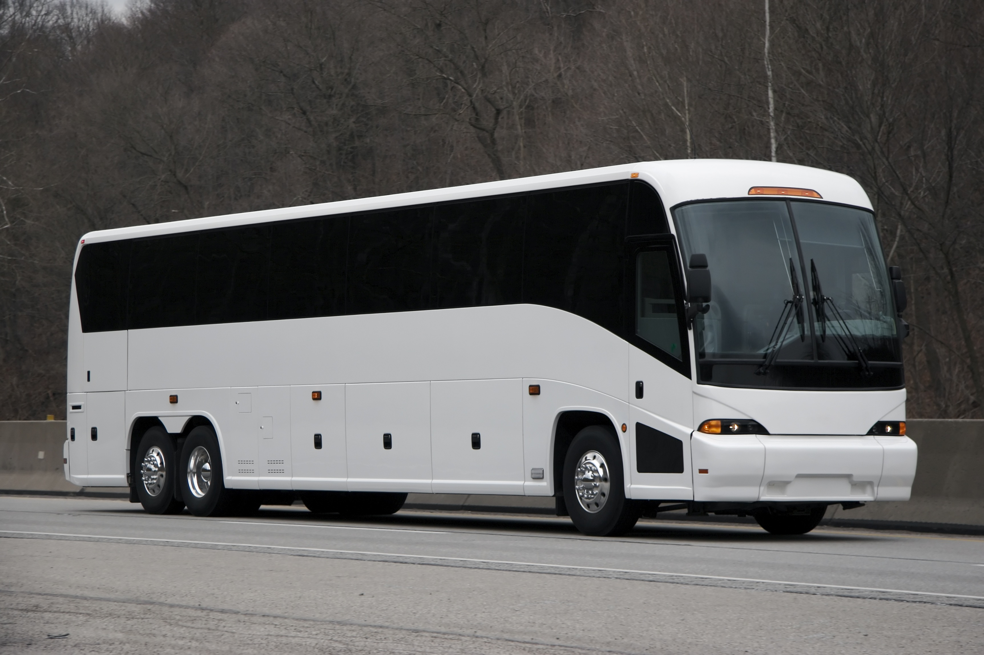
Coming home...
We anticipate an arrival time of midnight on Friday.
Once we cross the border in Detroit, we will send out a robo-call and email to parents. Your students may also call you when we are 30 minutes away from SMS.
Birth certificates & passports will be returned to your child as we pull into Saline.
Please don’t fall asleep and forget to pick
up your child. Yes, it really has happened!

Slide 14
and finally...
All birth certificates (or passports) and health forms are due ASAP.
Thank you for allowing your child to experience the Toronto trip. It promises to be a highlight of their educational experience at Saline Area Schools! We have high expectations for all participants and continue to be amazed at the level of maturity and professionalism that our students portray every year. We know that by continuing this level of excellence, our students will continue to represent our school and community with pride and integrity.

